Slide 1
建舜電子製造股份有限公司
2023年法說會簡報
Dec. 7, 2023

Slide 2
本簡報內容係依據會計師簽證之財務報表編製，財務報表依照IFRS編製，完整內容及資訊須依據財報為準。
本簡報資料可能包含對於未來展望的表述，該類表述是基於對現況的預期，但同時受限於已知或未知風險或不確定性的影響，因此實際結果將可能明顯不同於表述內容。
除法令要求外，公司並無義務因應新資訊的產生或未來事件的發生，主動更新對未來展望的表述。
JEM | 投資安全免責聲明

Slide 3
JEM | 2023年度法說會報告項目
1 | 公司簡介
2 | 營運報告
3 | 核心優勢＆產品發展
4 | 企業永續＆願景

Slide 4
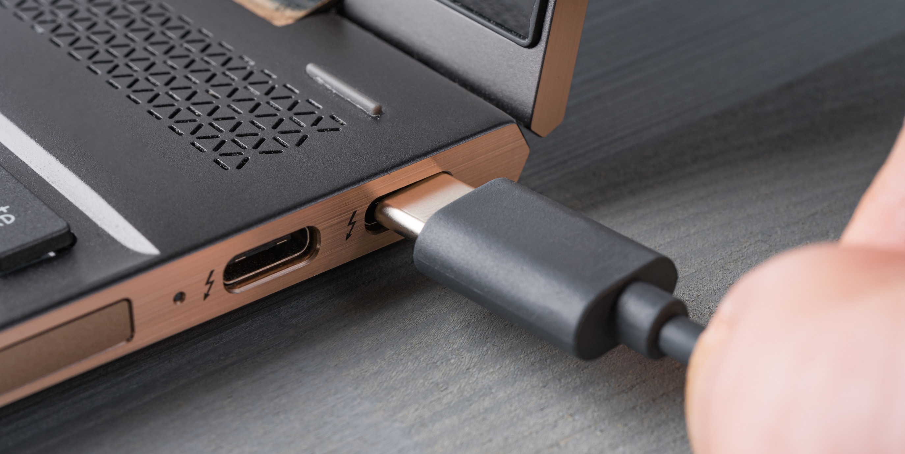
1. 公司簡介

Slide 5
JEM | 公司簡介
Main Product
創辦人
Cable Assembly (FATP)
Antenna
External Storage (EMS)
黃欽雄
集團員工人數
2,600
成立時間
2009 年掛牌，股票代號 3322
1977年
資本額
新台幣10.75億元

Slide 6
JEM | 建舜電- 全球佈局
湖北監利廠
Established in 2023
蘇州廠
Established in 2004
廣西廠
Engineer: 15
Employee: 300
Land: 6,000 m²
Facility: 12,000 m²
Buildings: 2
台北總公司
Established in 2007
Established in 1977
Engineer: 15
Sales: 20
Administration: 20
Engineer: 10
Employee: 300
Land: 5,800 m²
Facility: 6,000 m²
Buildings: 1
東莞廠
Established in 1993
Engineer: 110
Employee: 1,300
Land: 70,000 m²
Facility: 62,000 m²
Buildings: 3
泰國廠 (北柳府)
Established in 2012
Engineer: 20
Employee: 900
Land: 57,800 m²
Facility: 13,800 m²
Buildings: 2 +1(興建中)

Slide 7
2. 營運報告

Slide 8
JEM | 營運績效-最近季度
單位:新台幣/千元

Slide 9
JEM | 產品別營收狀況
單位:新台幣/千元
 | 2023年前三季 | 2022年前三季 | 2022年度 | 2021年度(調整後)
線裝連接線束 | 981,805 | 1,056,389 | 1,324,669 | 1,670,318
天線 | 55,213 | 59,767 | 79,351 | 122,561
高速產品 | 536,096 | 596,744 | 759,345 | 534,413
電子產品 | 182,690 | 215,968 | 288,575 | 462,255
材料及其他 | 287,709 | 221,778 | 313,942 | 251,158
合計 | 2,043,513 | 2,150,646 | 2,765,882 | 3,040,705
2021 (調整後)：2021.11因對原合併個體互動資通喪失控制力，故調整其影響數

Slide 10
JEM | 合併綜合損益表
單位:新台幣/千元
 | 2023年前三季 | 2022年前三季 | 變動% | 2022年度 | 2021年度 (調整後)
銷貨收入 | 2,043,513 | 2,150,646 | -5% | 2,765,882 | 3,040,705
銷貨成本 | 1,654,533 | 1,768,713 | -6% | 2,251,949 | 2,505,842
營業毛利 | 388,980 | 381,933 | 2% | 513,933 | 534,863
營業費用 | 337,595 | 283,100 | 19% | 380,174 | 409,864
營業淨利(損) | 51,385 | 98,833 | -48% | 133,759 | 124,999
業外收入及支出 | 47,807 | 72,185 | -34% | 63,121 | 71,376
稅前淨利(損) | 99,192 | 171,018 | -42% | 196,880 | 196,375
所得稅費用 | 27,261 | 38,198 | -29% | 41,400 | 17,676
稅後淨利(損) | 71,931 | 132,820 | -46% | 155,480 | 178,699
歸屬母公司淨利 | 72,097 | 133,266 | -46% | 155,883 | 178,990
每股盈餘 | 0.67 | 1.24 | -46% | 1.45 | 1.85
毛利率 | 19.0% | 17.8% |  | 18.6% | 17.6%
營業費用率 | 16.5% | 13.2% |  | 13.7% | 13.5%
2021 (調整後)：2021.11因對原合併個體互動資通喪失控制力，故調整其影響數

Slide 11
JEM | 合併資產負債表
單位:新台幣/千元
 | 2023年9月30日 |  | 2022年9月30日 |  | 2022年12月31日 |  | 2021年12月31日
 | 金額 | % | 金額 | % | 金額 | % | 金額 | %
現金及約當現金 | 477,489 | 15 | 351,432 | 13 | 350,797 | 14 | 172,586 | 7
應收帳款淨額 | 949,141 | 30 | 818,770 | 31 | 662,437 | 26 | 885,769 | 34
存貨 | 339,321 | 11 | 466,716 | 18 | 443,346 | 17 | 495,183 | 19
不動產、廠房及設備 | 993,888 | 32 | 736,507 | 28 | 841,597 | 32 | 720,746 | 28
資產總額 | 3,139,107 | 100 | 2,649,783 | 100 | 2,591,564 | 100 | 2,581,350 | 100
流動負債 | 1,518,904 | 48 | 832,460 | 31 | 721,533 | 28 | 1,081,340 | 42
負債總額 | 1,733,556 | 55 | 1,275,320 | 48 | 1,177,208 | 45 | 1,356,772 | 53
股本 | 1,075,065 | 34 | 1,074,657 | 41 | 1,075,065 | 41 | 1,046,858 | 41
權益總額 | 1,405,551 | 45 | 1,374,463 | 52 | 1,414,356 | 55 | 1,224,578 | 47
 | 2023年9月30日 | 2022年9月30日 | 2022年12月31日 | 2021年12月31日
流動比率(%) | 126 | 208 | 218 | 153
負債率(%) | 55 | 48 | 45 | 53
應收帳款周轉天數 | 108 | 108 | 102 | 78
存貨周轉天數 | 65 | 74 | 76 | 51

Slide 12
3. 核心優勢＆產品發展

Slide 13
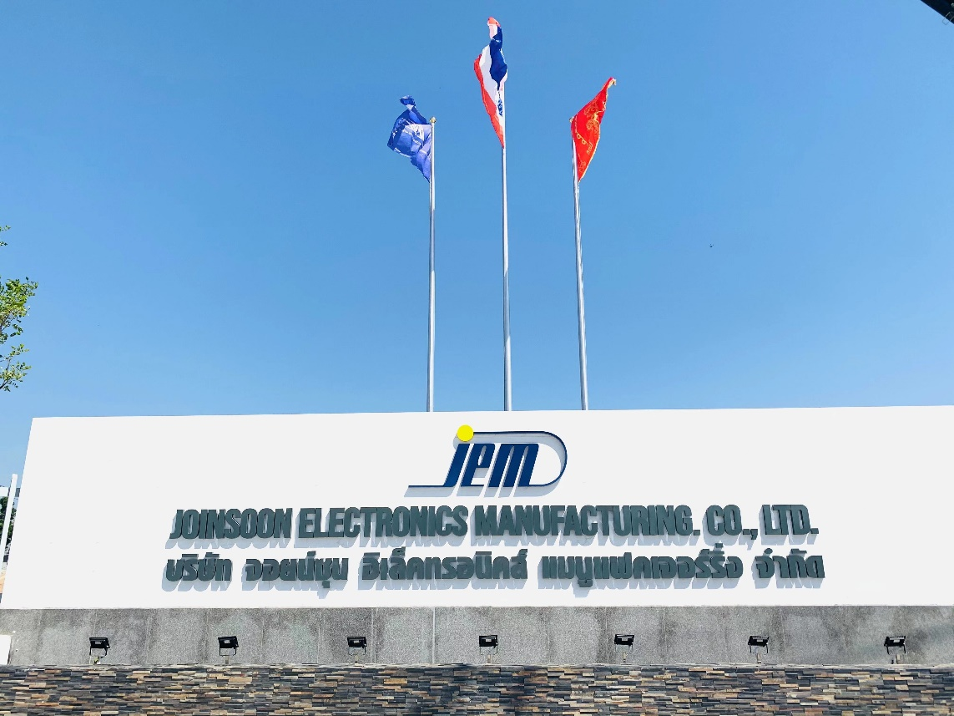
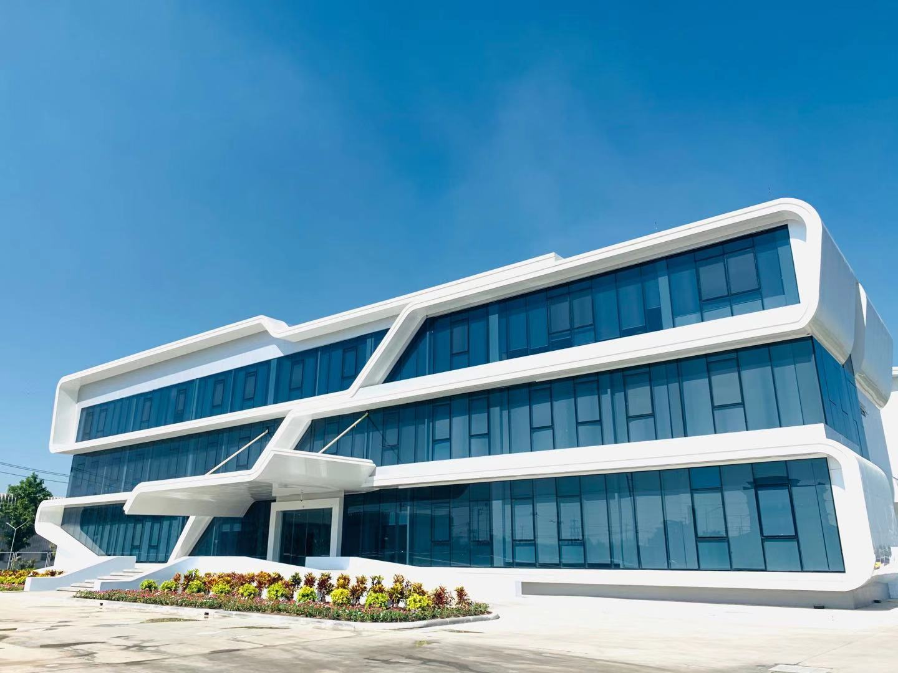
JEM | 建舜電- 全球佈局
規避美國關稅
出口便利
材料本地化供應
東南亞交貨
泰國本地運輸
出口越南/中國
產能充沛
直接人力充沛
投入自動化生產
服務
品質
JET land area total is 35 RAI (56,000 m²)
Labor qty: 1000
Notes:
Our Thailand factory set up in 2012, to consider tariff issue and covid-19, we bought a big land to build new Thailand factory in 2020. As you can see our land area is around 112,000 square meter, and it takes 40mins traffic time to international airport, and one hour to Bangkok city.
Now, our capacity is around 1.5kk~2kk per month, and this is only for one production building, we are collecting more demand to build phase II building in nearly future.
Later, allow me to show you the video of new Thailand factory, the video time is around 3 mins.

Slide 14
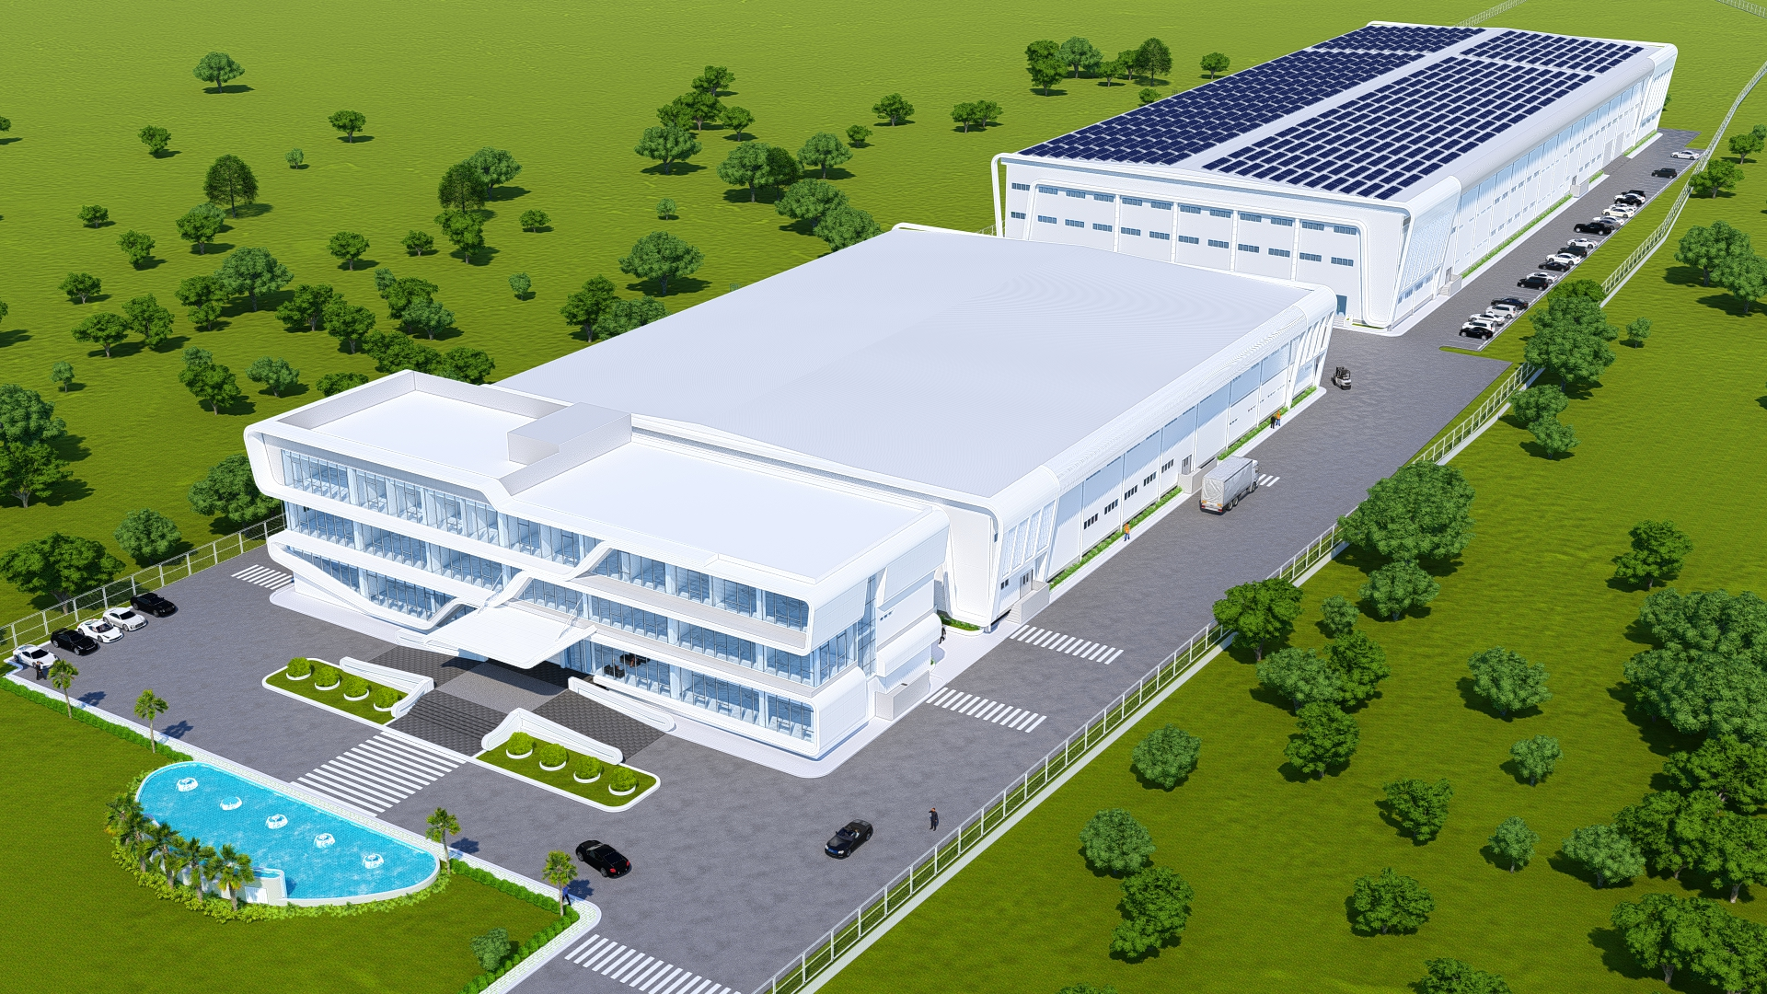
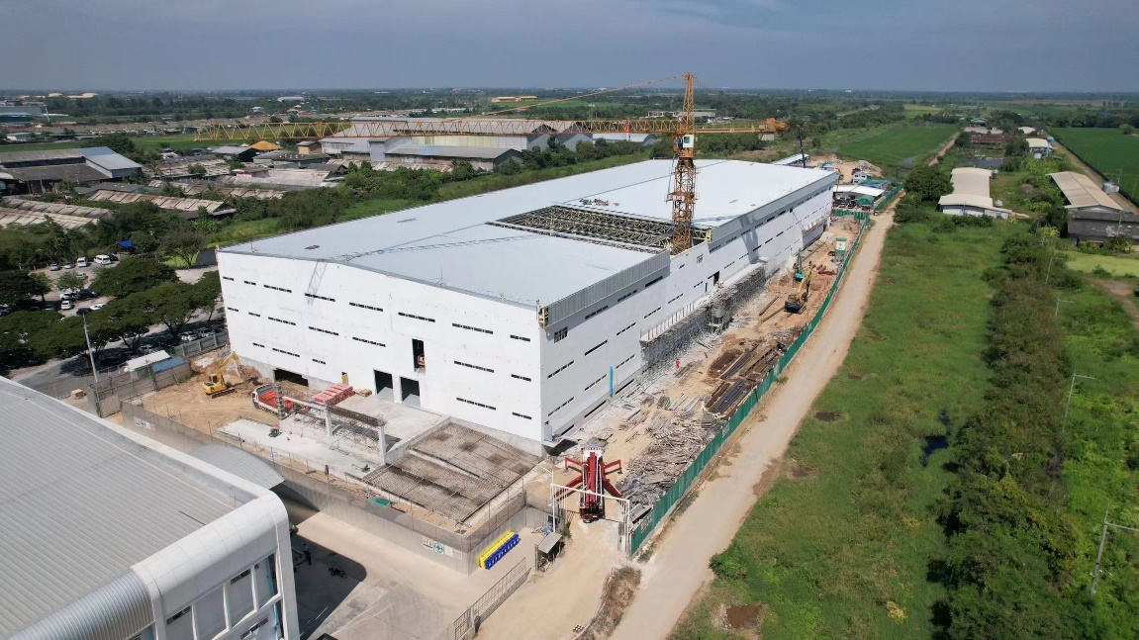
JEM | 泰國廠 – 二期建設
JEM Global Location Strategy
Phase II : Reserve for future project
SMT
Silicone Jacket Extrusion
FATP
Wire harness/Antenna
Plant C: 9,720m²
(90mx54m x 2FL)
Plant A: 9,558m²
^{(81m x 59m x 2 FL)}
Plant B: 38,232m²
^{(162m x 59m x 4 FL)}
^{(Phase#2)}
Plant C: Under Scoping
* 新車間(Plant B)落成：3/31/2024

Slide 15
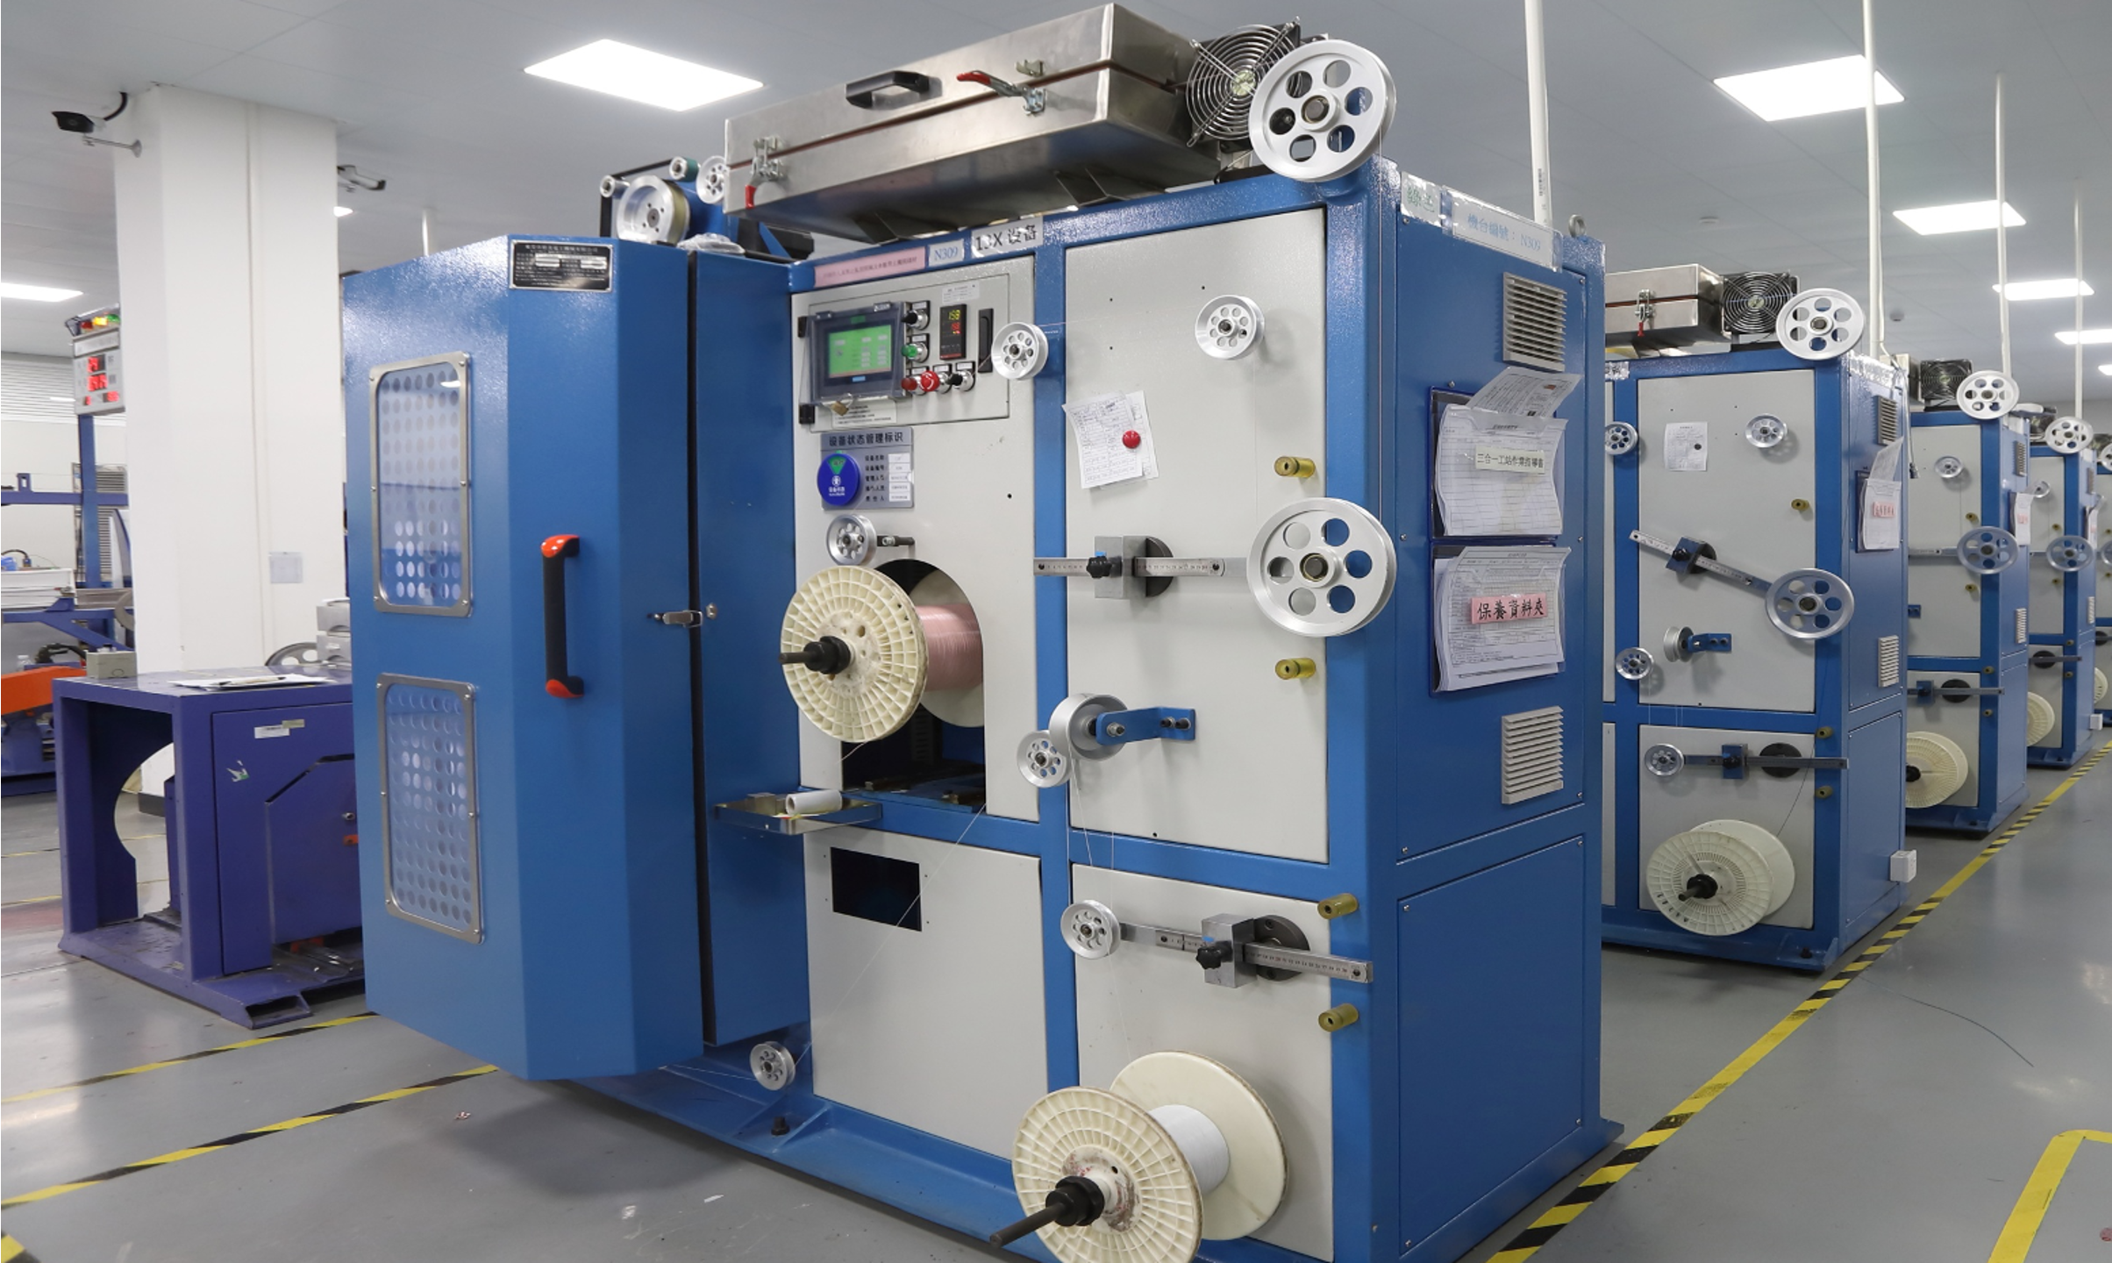
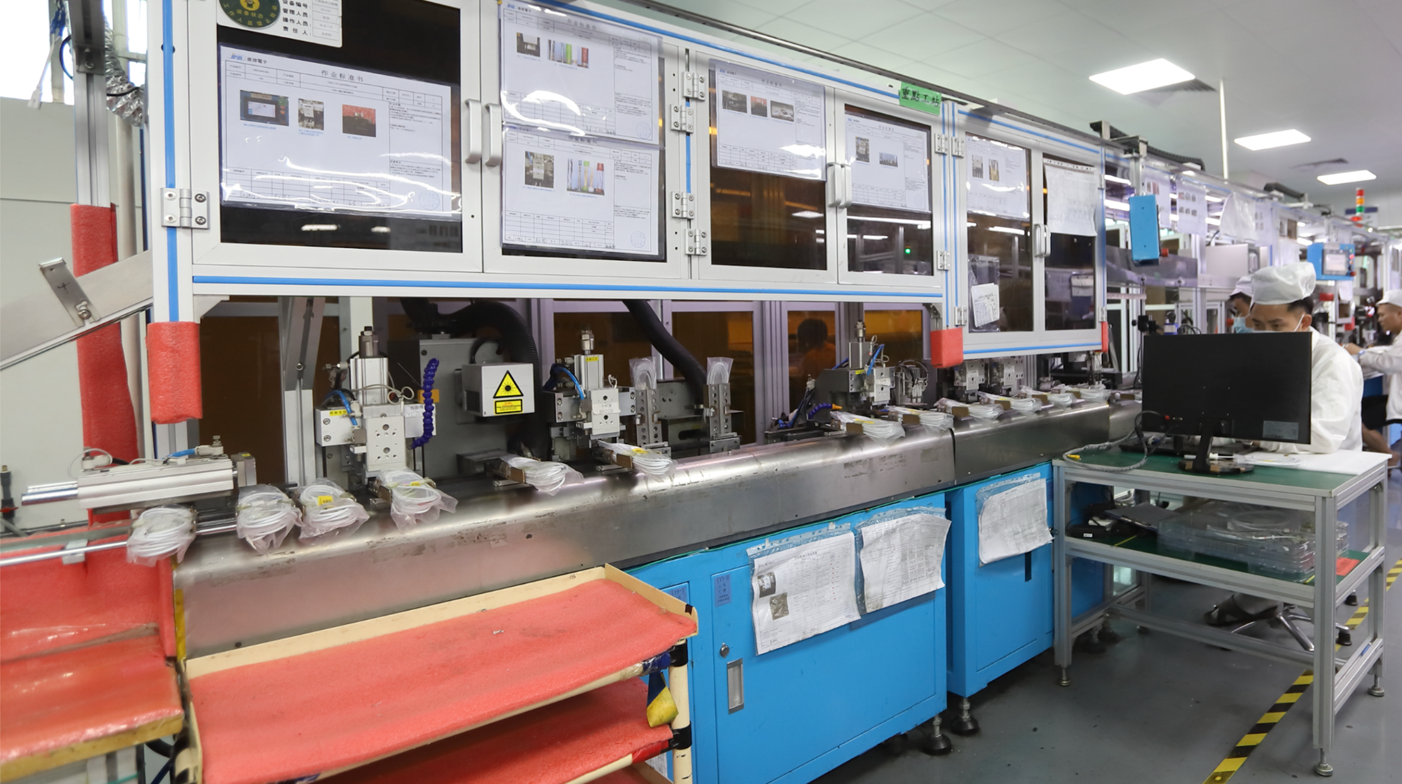
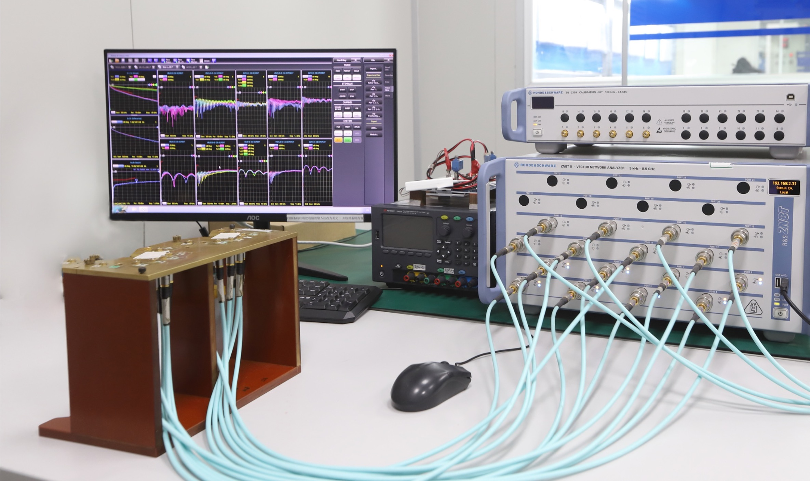
JEM | 核心競爭力: 高速線束
SMT 貼片
線材抽線
SMT生產能力
FA 檢驗能力
Real Time品質管控
精密抽線設備
PFAS-Free 製程
品質
線材組裝
測試驗證
高頻驗證能力
在線測試
CT Scaner
製程穩定
SFC製程追溯
關鍵製程模組化
FFC 組裝
自動化製程導入
Notes:
According to previous slide, JEM provides “one stop shop” service to Logitech.
So let me show you some photo of equipment in house.
Where raw cable production is for high speed cable and more focus on key station to liable signal integrity performance. There has tooling work shop in house where CMM mirror EDM for tool up in house. Also equip CT scanner goes with FA/CA ability. Reliability lab include for test lab of SI, EE, ME.

Slide 16
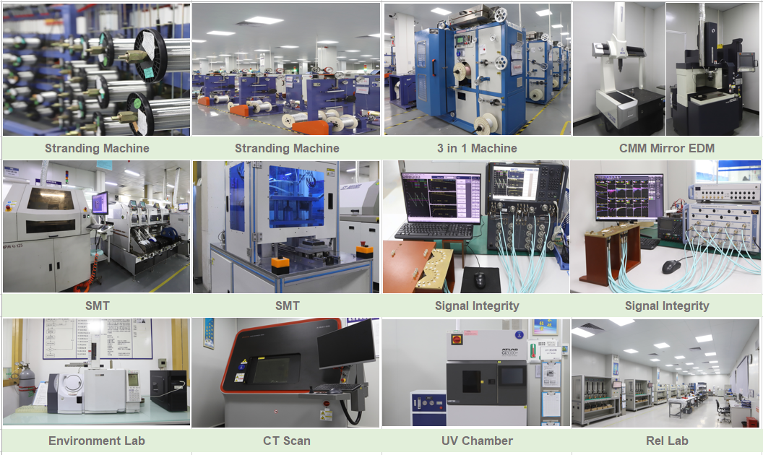
JEM | 核心競爭力: 一站式服務
抽線製程
組裝
SMT
模具開發
測試驗證
* 2024 JEM泰國中央實驗室建置完成。
Notes:
According to previous slide, JEM provides “one stop shop” service to Logitech.
So let me show you some photo of equipment in house.
Where raw cable production is for high speed cable and more focus on key station to liable signal integrity performance. There has tooling work shop in house where CMM mirror EDM for tool up in house. Also equip CT scanner goes with FA/CA ability. Reliability lab include for test lab of SI, EE, ME.

Slide 17
JEM | 2024年度 Product Roadmap
 | CQ4’23 | CQ1’24 |  |  | CQ2’24 | CQ2’24 | CQ3’24 | CQ4’24 | CQ1’25
Super Speed | USB4 Gen3 C to C Active cable (L: 3m)
 |  |  |  |  |  | PFAS-Free Process Implement
 |  | USB Type C cable 240W Anti-Arc Implement
Medical | Medical Cable Development
Wire Harness |  |  |  |  |  |  | Antenna/Wire harness Bring up in Thailand
* Wecome to have design challenge & Customized cable.

Slide 18
JEM | USB4 高速線束認證
No | SPEC | TID Award | TID#
1 | USB4 C/C Gen2, 1.8M, Twist | 10/20/20' | 4262
2 | USB4 C/C Gen3, 0.5M, Coax | 10/20/20' | 4263
3 | USB4 C/C Gen3, 0.8M, Coax | 10/20/20' | 4264
4 | USB4 C/C Gen3, 1.0M, Coax | 05/13/21' | 5626
5 | USB4 Gen3 5A SPR 0.3m-Coax | 01/27/22' | 7136
6 | USB4 Gen3 5A EPR 1.0m-Coax | 04/27/22' | 7273
7 | USB4 Gen3 5A EPR 0.8m-Coax | 12/08/22' | 8763
8 | USB4 Gen3 5A EPR 0.5m-Coax | 12/17/22' | 8811
9 | USB4 Gen3 5A EPR 0.3m-Coax | 12/17/22' | 8812
10 | USB4 Gen2 5A EPR 1.8m-twist pair | 04/27/22' | 7274
11 | USB4 20Gbps 240W Type C /C 1.0m Twist Pair | 06/28/23' | 9642
12 | USB4 20Gbps 240W Type C /C 1.0m Twist Pair(Screw Type) | 06/28/23' | 9641
13 | USB4 20Gbps 240W Type C /C 1.0m Twist Pair(Orange) | 05/04/23' | 9430
14 | USB4 40Gbps 240W Type C /C 1.0m Twist Pair | / | TBC

Slide 19
醫療
通訊
環保
工業
高速傳輸
JEM | 市場開拓
手持式醫療檢測裝置
醫療設備
醫療器材
5G產品應用
教學系統
複印機
車用電子
POS
工業物聯網
高速傳輸線
連接器
SSD/HDD
環保材質應用
太陽能
氫能源

Slide 20
4. 企業永續＆願景

Slide 21
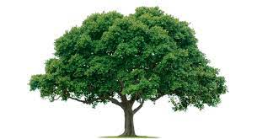
JEM | 永續企業 - 環境
減少碳排放，愛護地球。
無全氟/ 多氟烷基物質 (PFAS Free)製程投入 。
著重回收包裝。
建設綠色工廠。
產品環保設計。
泰國廠綠色建築
太陽能儲電
雨水回收系統
ISO14064認證取得
月檢視碳排放
綠能產品規劃
2020
2021
2022
2023
2024
2025
月檢視碳排放數據
ISO14064認證準備
碳排放輔導公司啟動
啟動廢水/碳排放減少 3%.
二氧化碳&廢氣調查
Notes:
The next slide is sustainability roadmap, the “E” in ESG is states Environment, “S” for social, and “G” for governance. Let me introduce how we do for Environment.
Since year 2020, JEM already started to review data of CO2 energy consumption and greenhouse gas emissions, also submitted report to Logi SER review.
In 2021, JEM kicked off carbon emission plan to decrease 3% water and electricity by pcs.
This year, we plan to sign consultant contract of carbon emissions in Sept., and proceed internal training.
In coming year 2023, we will kick off carbon emission plan by monthly to review in JEM HQ and all factories to confirm the data and information is valid. After that, we expect to get ISO 14064 certification in Q4 of 2023.
For the phase II construction in Thailand factory, we plan to set up solar energy generation and rain water recycle system in 2024 once we success to gain more orders.

Slide 22
JEM | 永續企業 - 社會責任
01
Labor
勞工福利
02
Health and Safety
健康安全
03
Public Hygiene
環境衛生
04
Morality
道德
Prohibition of hiring underage workers.
Compliant working hours by Government.
Compliant wages and benefits.
Prohibition of violence, sexual harassment, sexual abuse…etc.
Implement equality for all employee.
Can’t hire indentured labor, involuntary, prison labor…etc.
Work environment safety.
Emergency plan, such as compliant fire detection and suppression equipment, unobstructed escape route…etc.
For work-related injuries and illnesses, provide necessary medical services.
Factory environmental hygiene management.
Must considered, assessed, and controlled the impact on workers of physical demanding job.
Provide smoothly health and safety communications.
Compliant ISO14001 of environmental responsibility.
Prevent pollution and save electricity.
Proper disposal of hazardous materials and solid waste.
Effective management of air emissions and water control.
Reduce energy consumption and greenhouse gas emissions.
Prohibited of bribery, corruption, and extortion...etc.
Information confidentiality.
Intellectual property.
Fair trading, advertising and competition.
Privacy of personal information protection, and Anti-Retaliation Policy.
Notes:
In accordance with SER requirements, JEM continues to follow up RBA 7.0 requirements for those regulation with labor, healthy and safety, public hygiene, and morality.

Slide 23
JEM | 永續企業 - 公司治理
ESG 公司永續治理組織成立。
關懷社會。用心經營。傳承永續。
ESG 集團組織圖
董事長
黃欽雄
祕書
任柏蓁
永續主管
歐耿宏
東莞廠
黃欽基
蘇州廠
駱榮滄
廣西廠
黃欽基
泰國廠
黃欽雄
台北總公司
歐耿宏
Notes:
For the governance, Jem from a dedicated Logitech SER team across Dongguan, guangxi, SZ.
ESG implement self-practice and lead by CSR director – Kevin Ou, following is our ESG org. chart and member.
Thailand facility warm up SER & ESG – labor training.

Slide 24
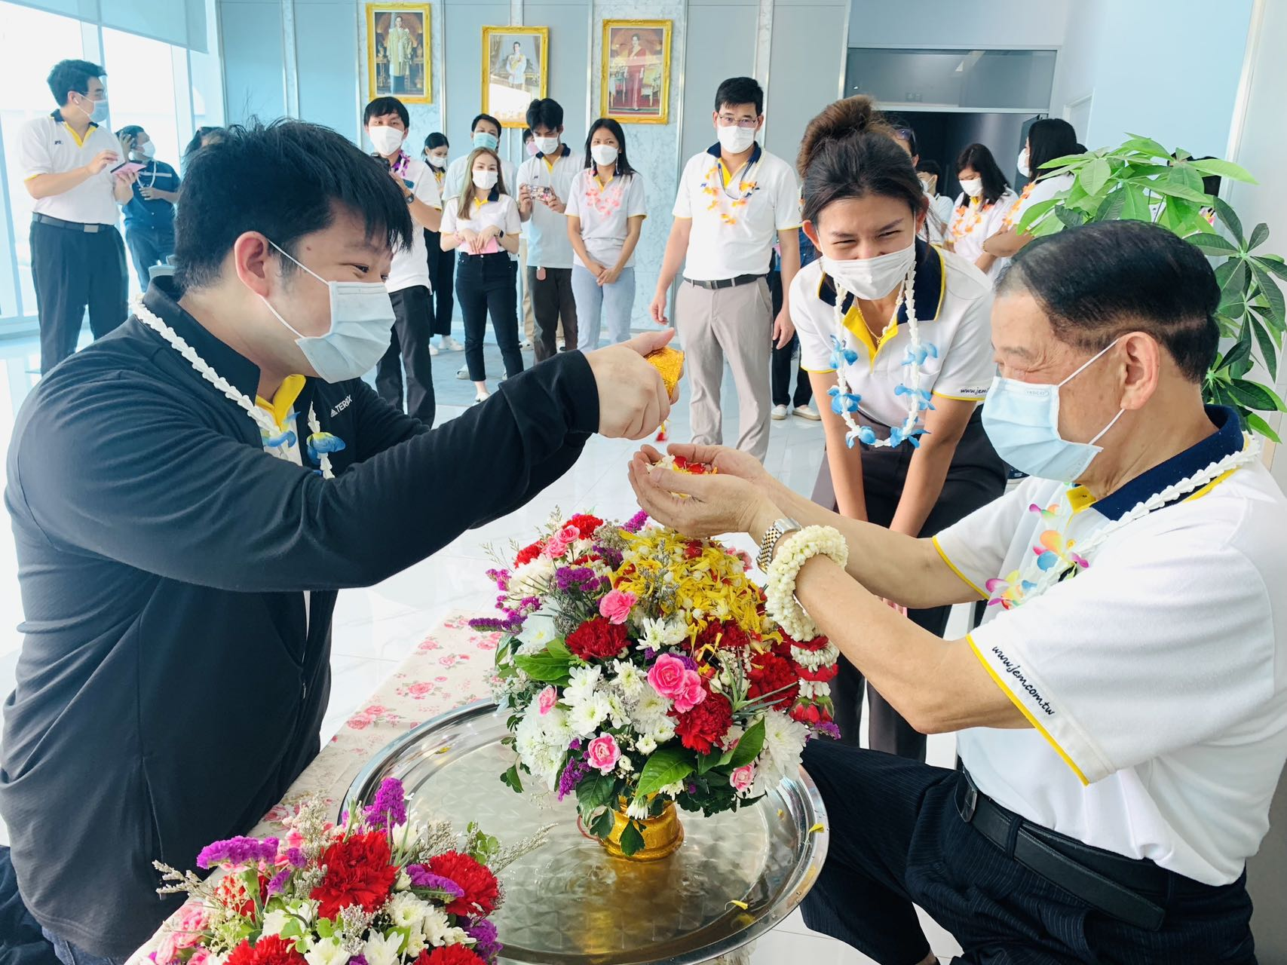
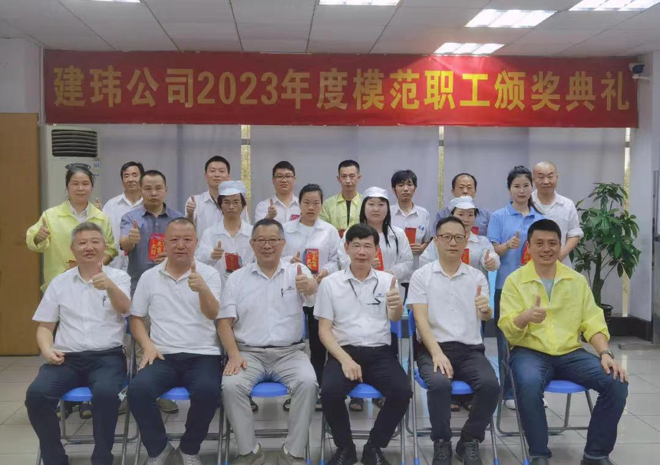
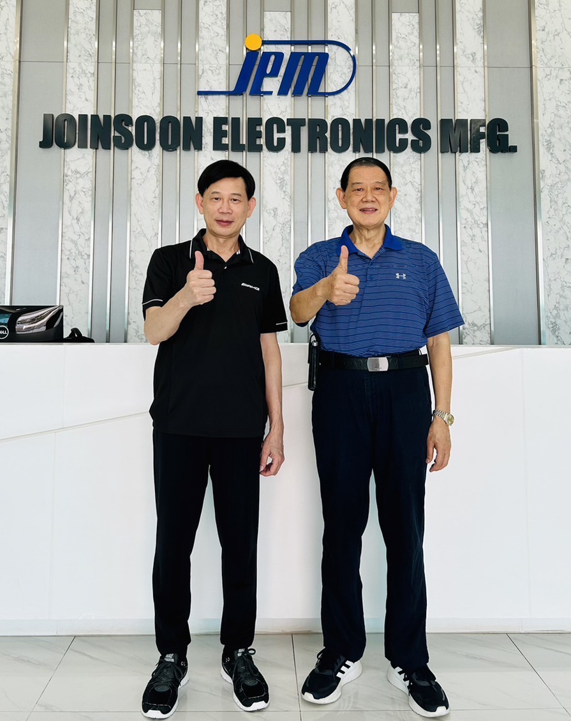
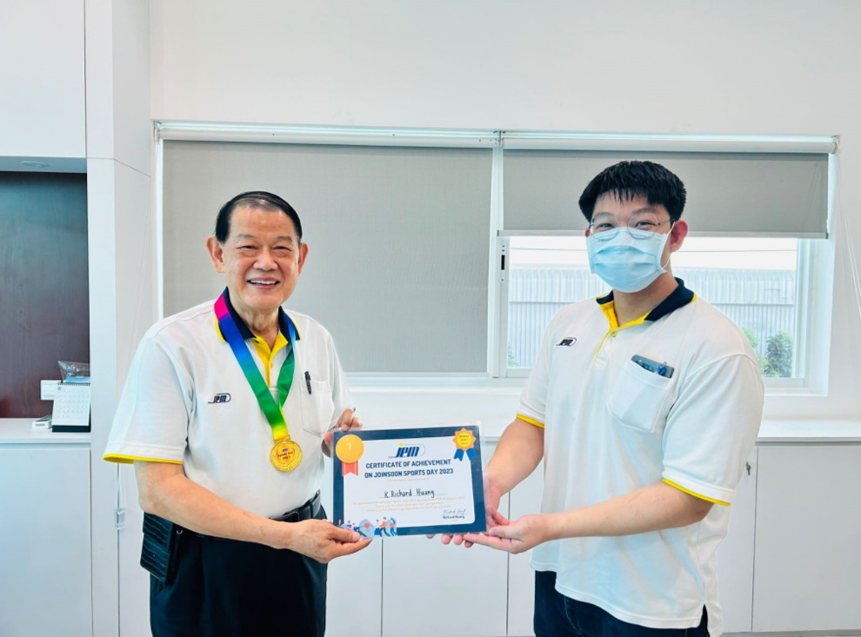
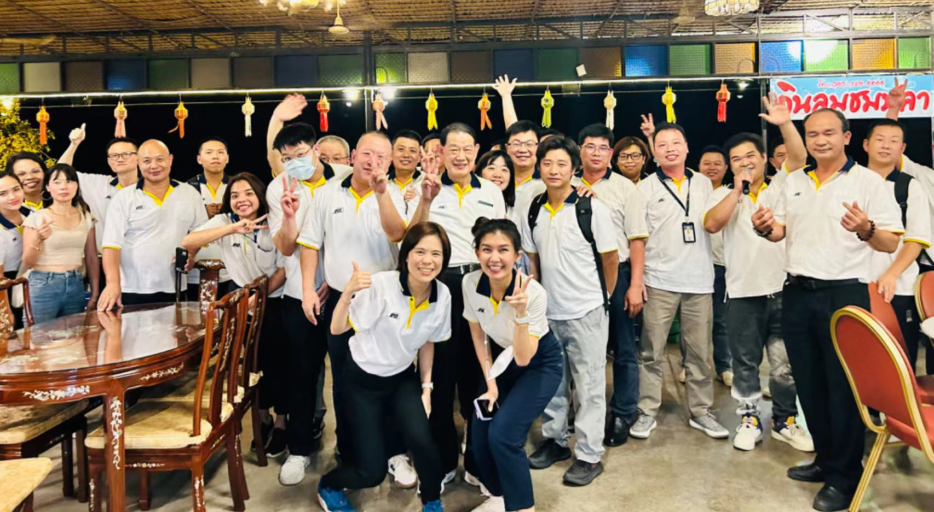
JEM | 永續企業 - 傳承
泰國-宋干節
模範勞工頒獎
建舜集團創辦人
Richard Huang
Eric Huang
泰國-新生代幹部
泰國-新生代幹部

